Slide 1
House Price Predictor
Predict The Market Value of Properties
Group no : 10
Group Members
ALDRIN SIMENTHY
GREESHMA PRASAD P
JYOTHIS K S
VISMAYA DINESH
Guided by
Vivek m v

Slide 2
Contents
Introduction
Project Objective
Technology Used
Tools Used
Software Requirements
How It Works?
More About Dataset
Diagrams & Graphical User Interface
Future Enhancements & Conclusion

Slide 3
Introduction
Every single organization in today’s real estate business is operating fruitfully to achieve a competitive edge over alternative competitors. There is a need to simplify the process for a normal human being while providing the best results.
The world is shifting from manual to automated systems. The objective of our project is to reduce the problems faced by the customer. Proposed work aims at predicting the price of houses based on different features and also measure the facilities available nearby the location.

Slide 4
Problems faced during buying a house:
Buying a house is a stressful thing.
Buyers are generally not aware of factors that influence the house prices.
Many problems are faced during buying a house.
It is not possible to predict the future prices of homes mentioned by the customer.
To contact a broker directly. This just creates a middleman and increases the cost of houses.

Slide 5
For overcoming the drawback, We a need for an updated and automated system.
The objective of our project is to reduce the problems faced by the customer.
Proposed work aims at predicting the availability of houses based on different features of the houses and the facilities available nearby the location of the houses, that are:
1. Number of bedrooms (1BHK, 2BHK and 3BHK etc..).
2. Number of bathrooms, carpet area, built-up area, the floor etc..
3. Age of the property.
4. Education facilities.
5. Medical facilities.
6. Transport facility such as availability of bus, trains and flights.
7. Shopping facility such as small markets, general stores, shopping malls.

Slide 6
Project Objective
Our project is a machine learning app, based on certain specifications of your future home it will try to predict the most accurate price.
Our project, predicting the house prices in Kochi, Chennai, Bangalore, Mumbai, Delhi and Kolkata.
Different models are used to predict the property price.
Our models are evaluated on the Root-Mean-Squared-Error (RMSE).
The result of this research proved gives an accuracy of more than 85%.

Slide 7
Technology Used
Machine Learning
Machine learning is a method of data analysis that automates analytical model building. It is a branch of artificial intelligence based on the idea that systems can learn from data, identify patterns and make decisions with minimal human intervention.
In general, any machine learning problem can be assigned to one of two broad classifications:
Supervised learning
Unsupervised learning.

Slide 8
Python
Python is an interpreted, high-level and general-purpose programming language. Python's design philosophy emphasizes code readability with its notable use of significant indentation.
Flutter
Flutter is an open-source UI software development kit created by Google. It is used to develop applications for Android, iOS, Linux, Mac, Windows, Google Fuchsia, and the web from a single codebase.

Slide 9
Tool Used
Scikit Learn
Flask
Pandas
NumPy
SciPy

Slide 10
Software Requirements
User side
Platform : Android
Operating System : Android – Version 6.0 above ( API 23 above )
Hardware : Smartphone at least 1GB RAM
Developer side
Android SDK 23
Android Studio
Flutter SDK
Anaconda
PyCharm

Slide 11
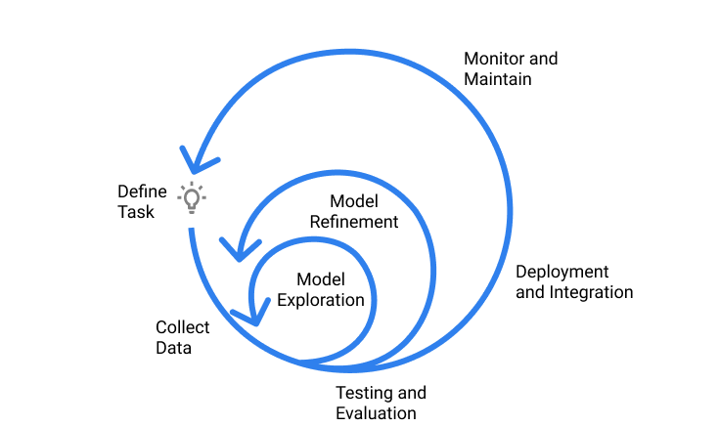
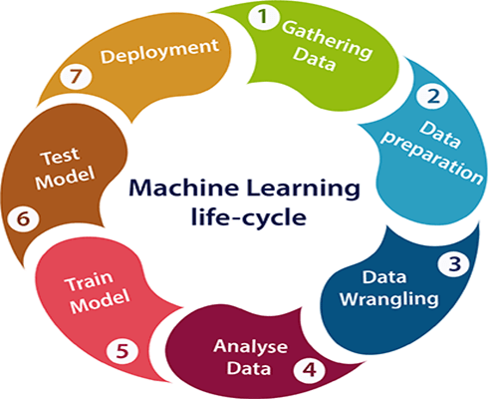
Development Model

Slide 12
How It Works ?
First step was to collect the data, We collected data from different sources and merged them together to form our data set.
Then, Data preprocessing is the process of cleaning our data set. There might be missing values or outliers in the dataset.
Since the data is broken down into two modules: a Training set and Test set, we must initially train the model. The training set includes the target variable.
The different types algorithm is applied to the training data set.
Based on the generated graphs we predict the cost of the Houses.
Integrating with UI : After the trained model is ready, then integrated with the front end using Flask in python.

Slide 13
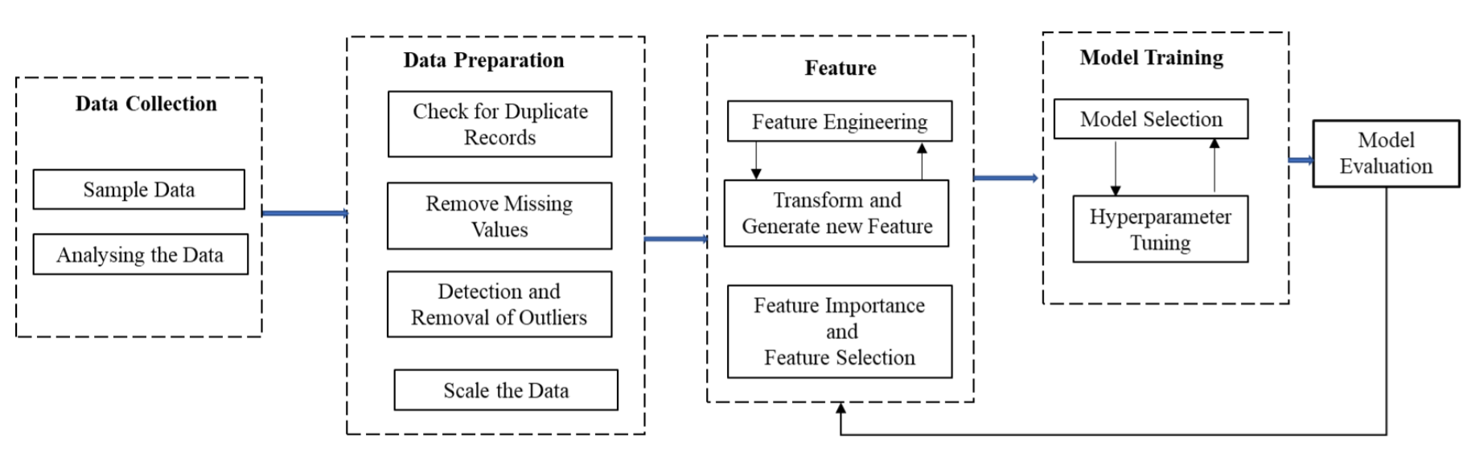
Research framework for the housing price problem.

Slide 14
More About Dataset
Dataset Consists of following fields:-
Area : Total Square feet
Location : Location of property
Year_Built, Year modify : Age of the Property
BHK, Bathrooms
1stFlrSF : Total Square feet in first floor
2ndFlrSF : Total Square feet in second floor
Col - 1 to Col – 42 : These are the other features we measured:
Facilities of houses : Balcony, Frontage, Kitchen etc..
Other data such as : Education facilities, Medical facilities, Shopping facility etc..

Slide 15
Insights of Data
Training data
There are more than 1000 rows and 42 features in training data.
Training data shows the collection of property details.
There are more than 130 unique locations.
Testing Data
There are more than 3000 rows and 42 features in training data.
There are more than 150 unique locations.
There are more than 30 additional cities in test data.

Slide 16
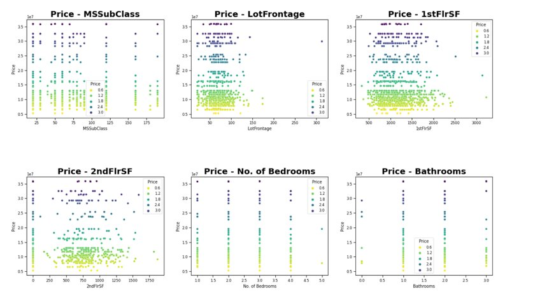
Visualizing numerical predictor variables with Target Variables

Slide 17
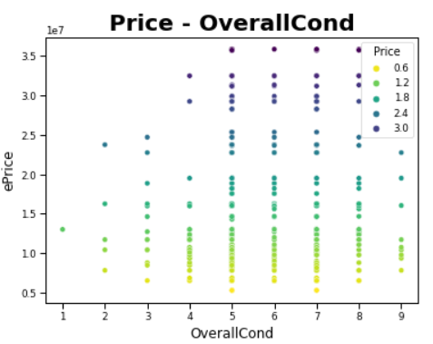
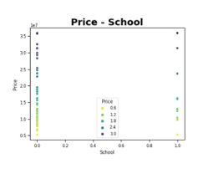
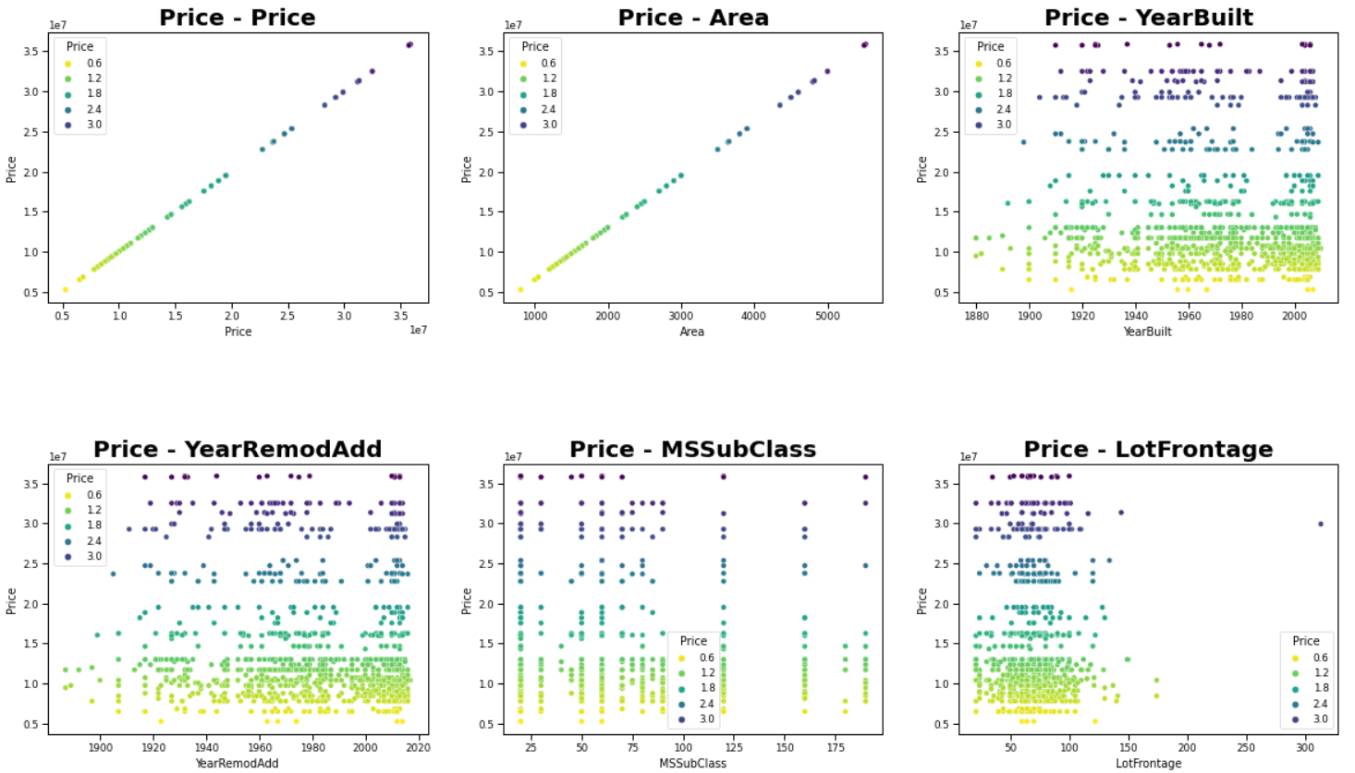
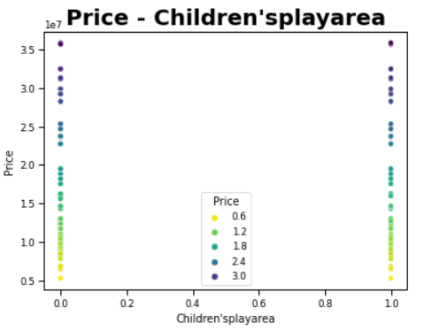
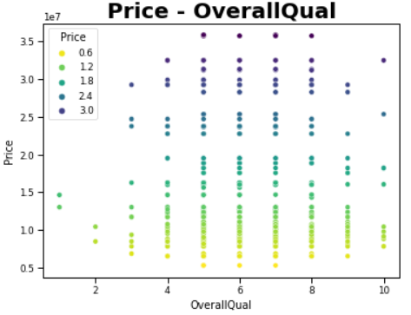
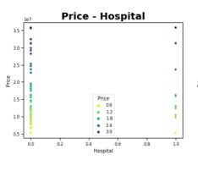
Continues...

Slide 18
Models Used
Decision Tree Regressor
Linear Regression
Ridge Regression
Lasso Regression
Elastic Net Regressor
Extra tree Regressor
Support vector Regressor(SVR)
Gradient Boosting
Light GBM
To make final predictions, We blended above models predictions together to get more robust predictions. Blending model using best models.

Slide 19
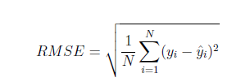
Score Measure: RMSE
The score measure presented in the competition is the root mean squared error of the test set price.
Where y_{i} is the predicted price of the property and y is the actual price of the i^{th} property.

Slide 20
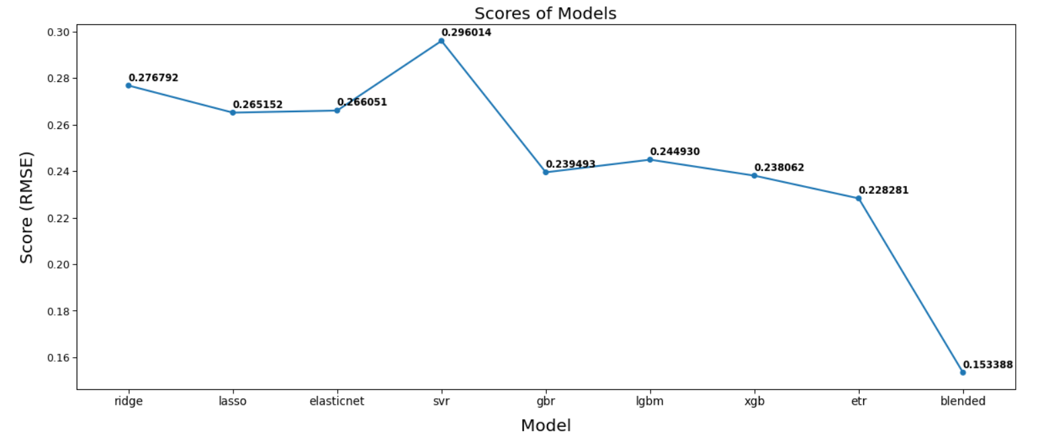
RMSE of All Models

Slide 21
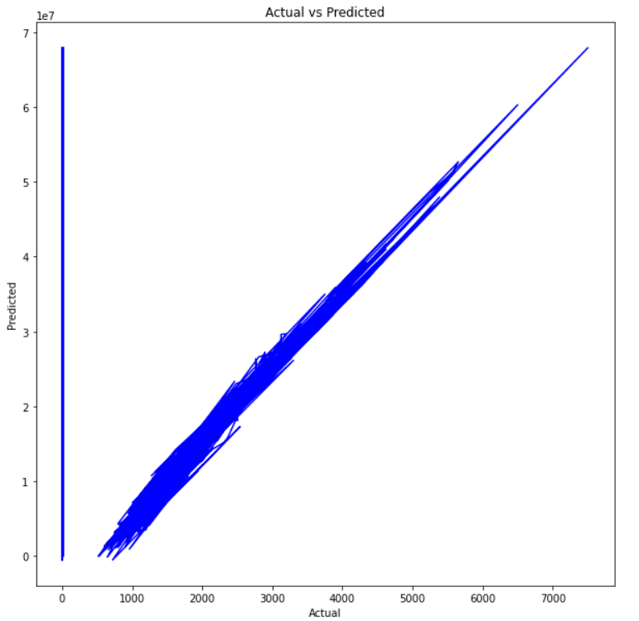
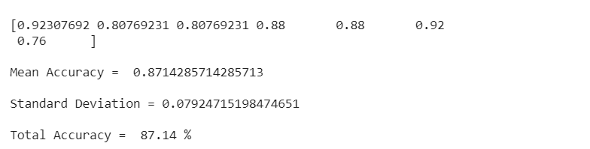
Results
Accuracy of the Prediction:
Actual vs predicted price graph based on the dataset:

Slide 22

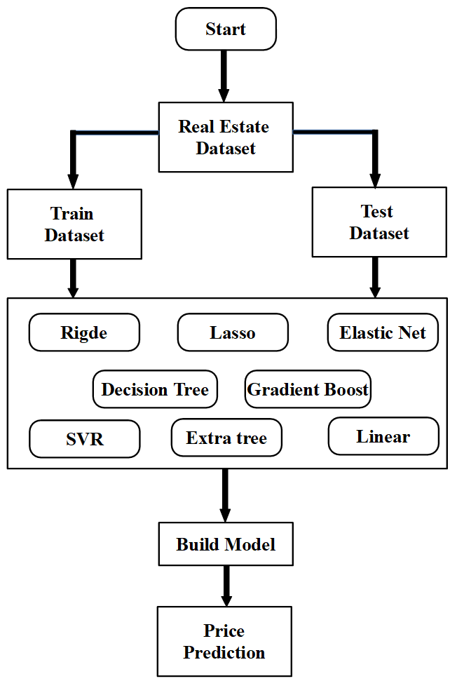
The Generic Flow of Development

Slide 23
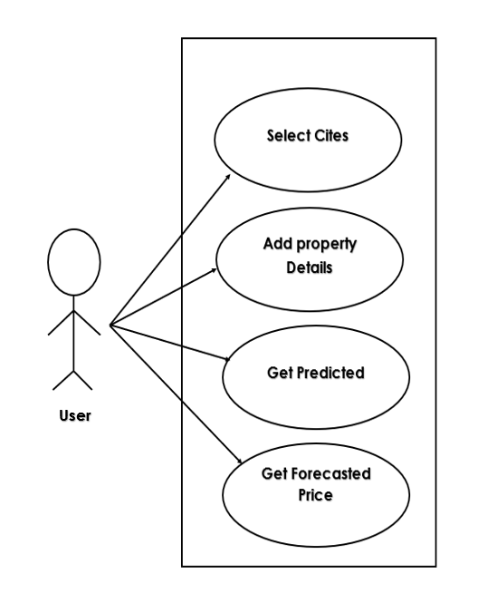
Use Case Diagram

Slide 24
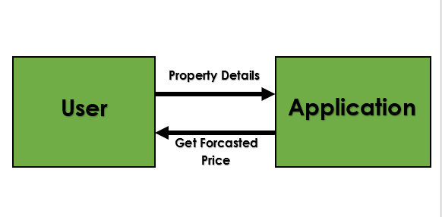
Context Diagram

Slide 25
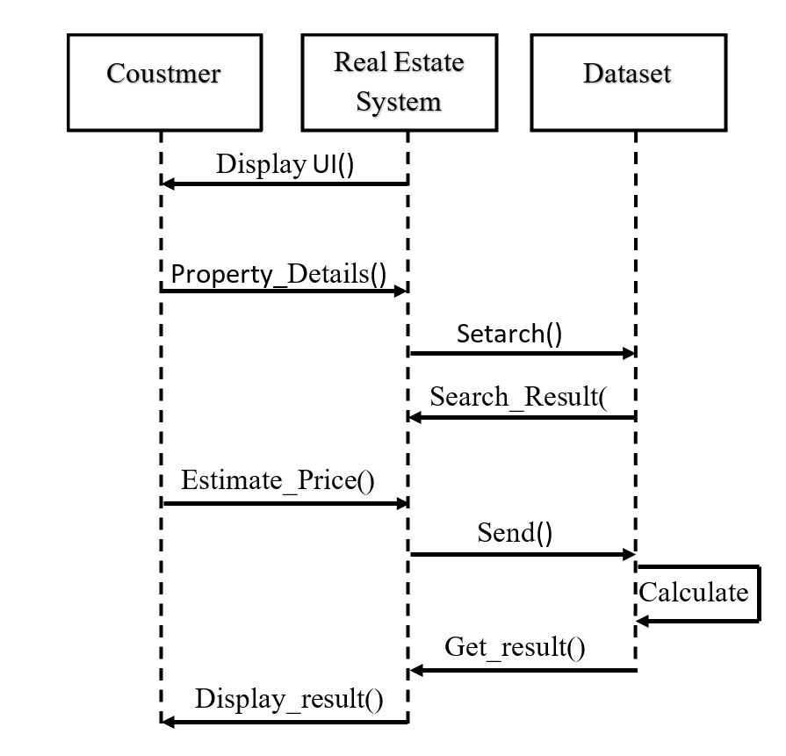
Sequence Diagram
Fffff
House Price Prediction
Search()

Slide 26
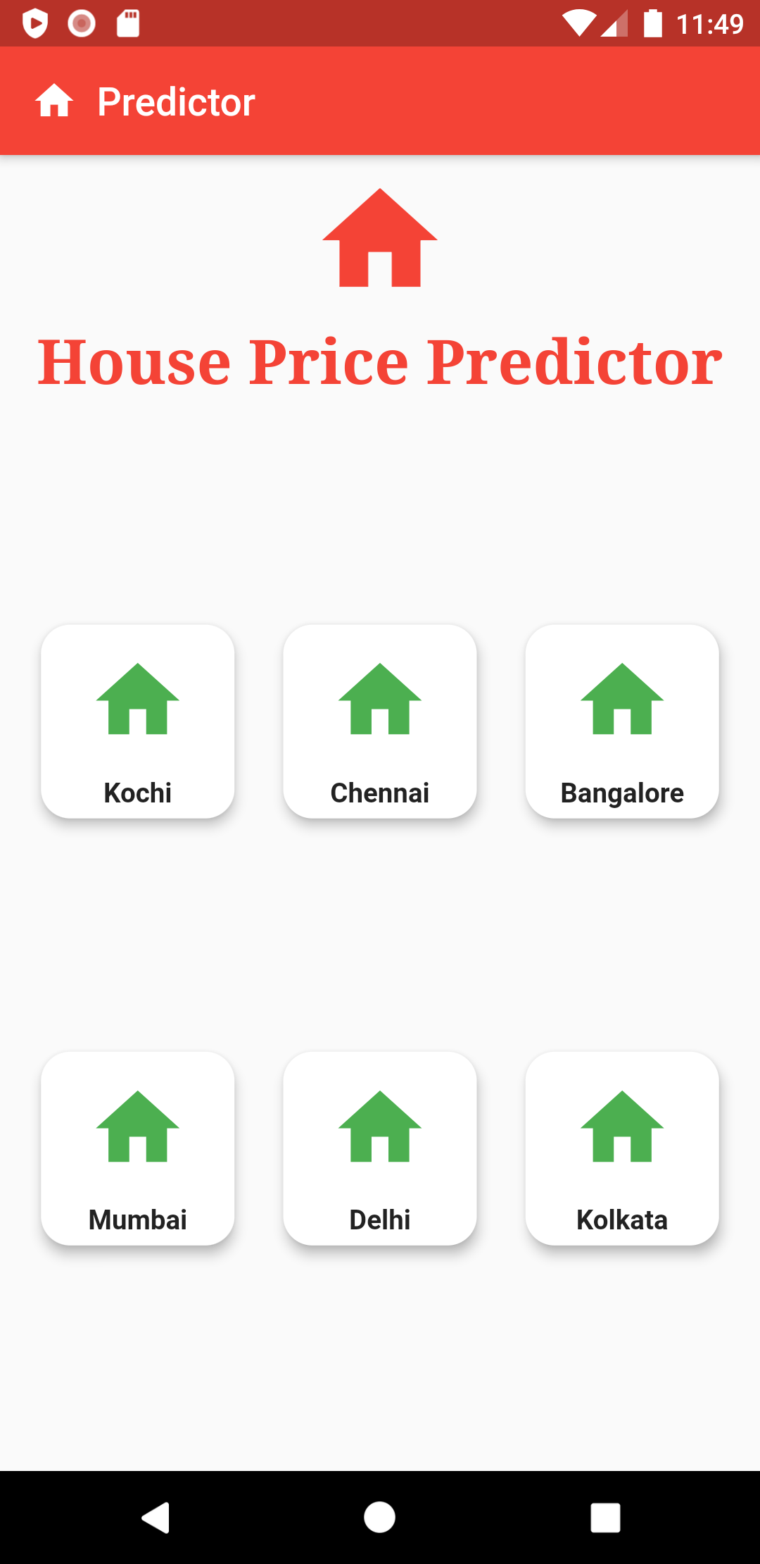
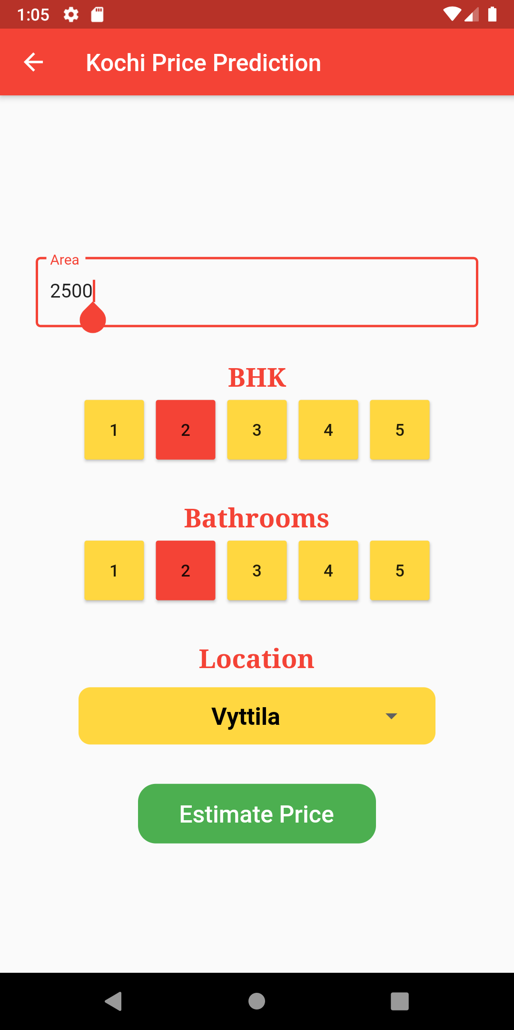
Graphical User Interface
Android Application

Slide 27
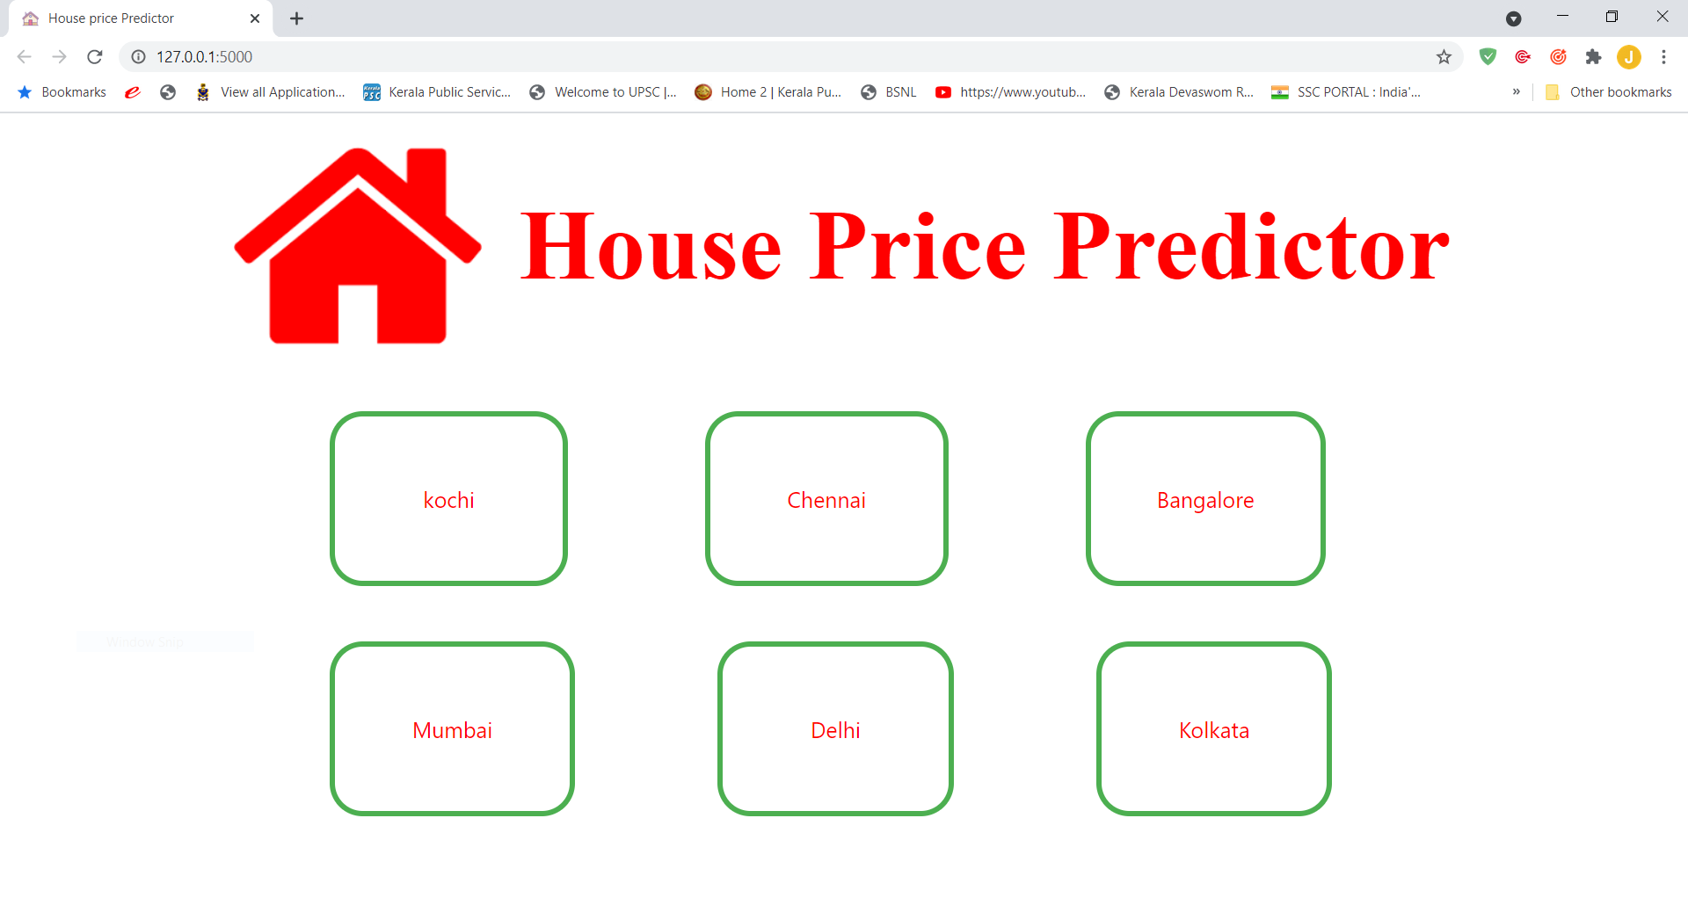
Web Application
Home Page

Slide 28
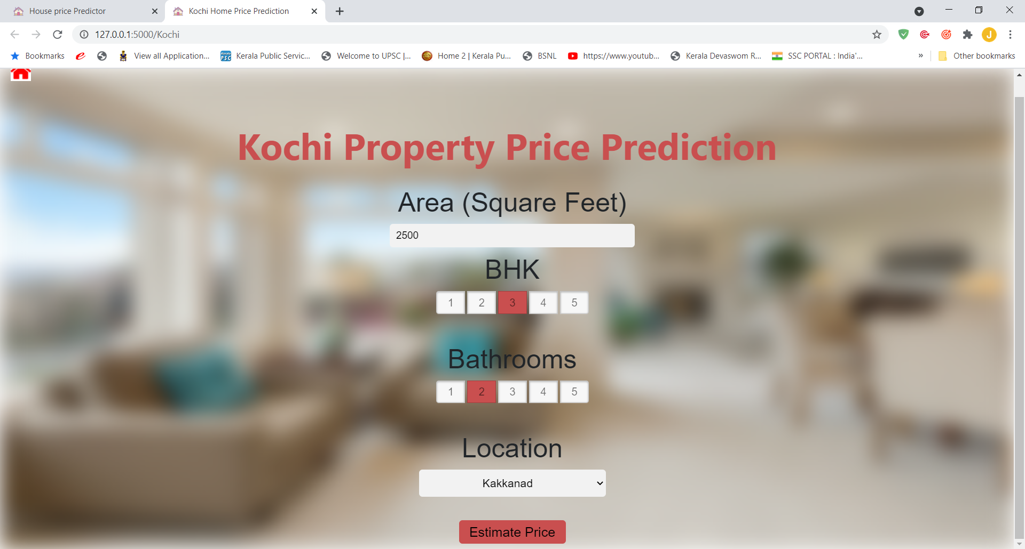
Add Property Details

Slide 29
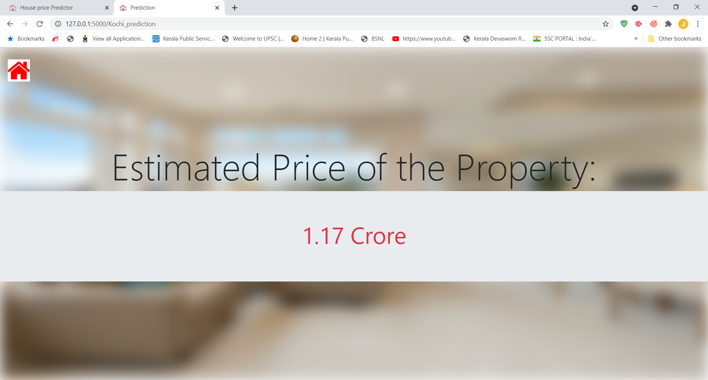
Price Prediction

Slide 30
Future Enhancements
Add Additional features like air quality and crime rate etc.
Expanding it to other cities.
To make the system even more informative and user-friendly.
Including Google map facility.
Add a facility to contact owner directly.
Develop an Advanced Real Estate System.

Slide 31
Conclusion
In this project we uses the most fundamental machine learning algorithms and different kinds of models are used.
Work is implemented using Scikit-Learn machine learning tool.
We blended all models together to get more robust predictions.
The result of this research proved gives an accuracy of more than 85%.
In future the dataset can be prepared with more features and advanced machine learning techniques.

Slide 32
THANK YOU

